Slide 1
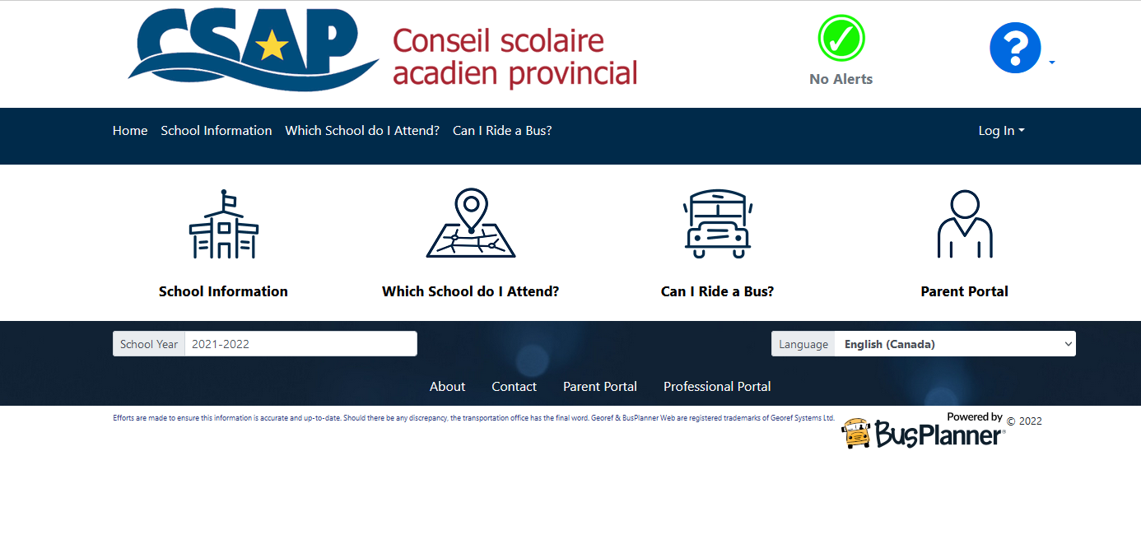
Busplanner Parent Portal Registration
https://csap.mybusplanner.ca/

Slide 2
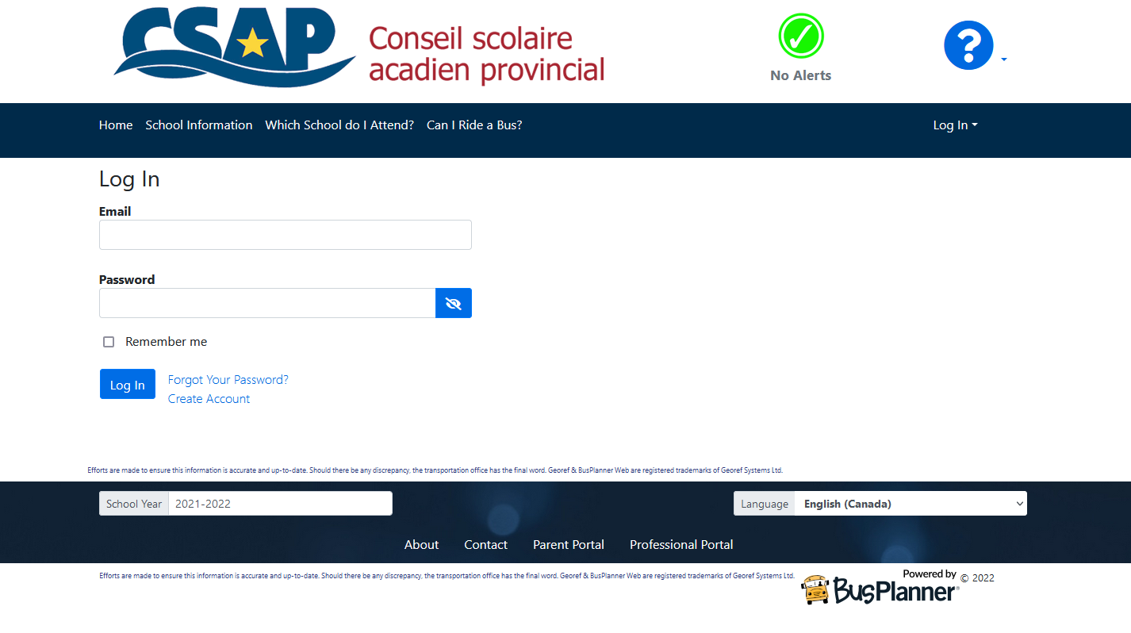
Log In Page
Using the link below :
https://csap.mybusplanner.ca/Login?ReturnUrl=%2FSubscriptions%2FChildTransportInfo
Create a parent profile by using an email and password

Slide 3
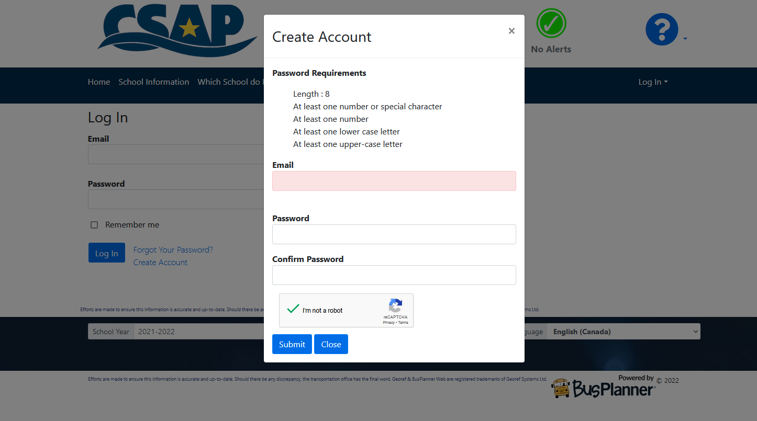
Create Account :

Slide 4
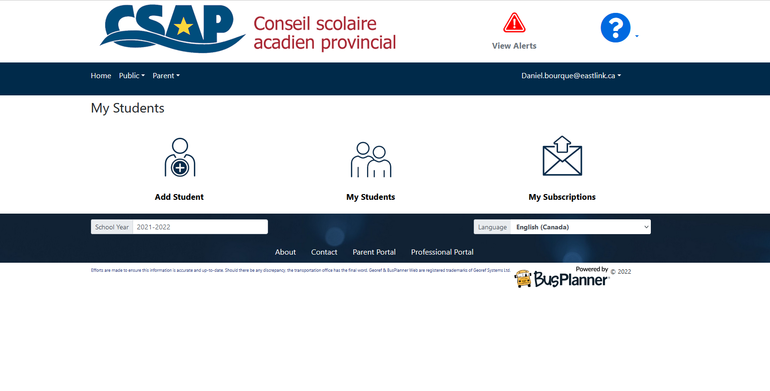
Parent Portal Site
Click On Add Student
You will need Student ID
Student ID can be found on report card or school can provide for new registrations

Slide 5
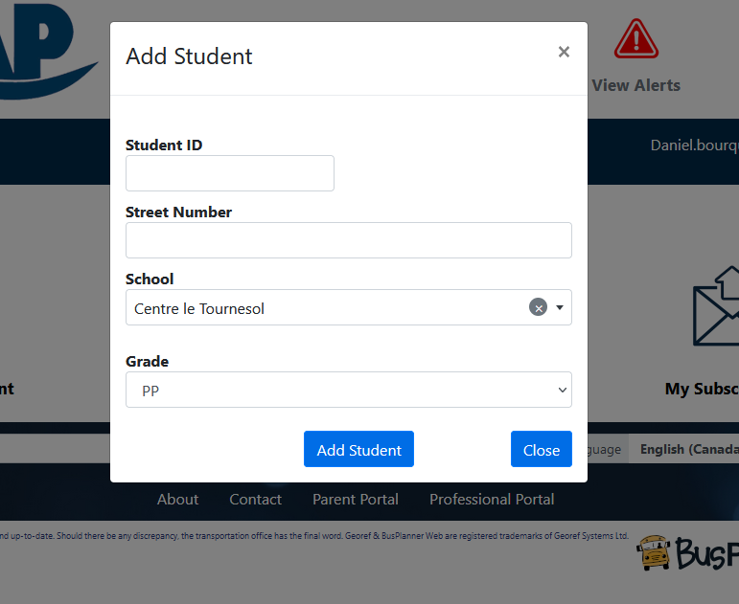
Add Student
Input student Id in the student Id field
Address field: PLEASE INPUT THE HOUSE NUMBER ONLY
Select Correct School
Select Grade
Select Add Student

Slide 6
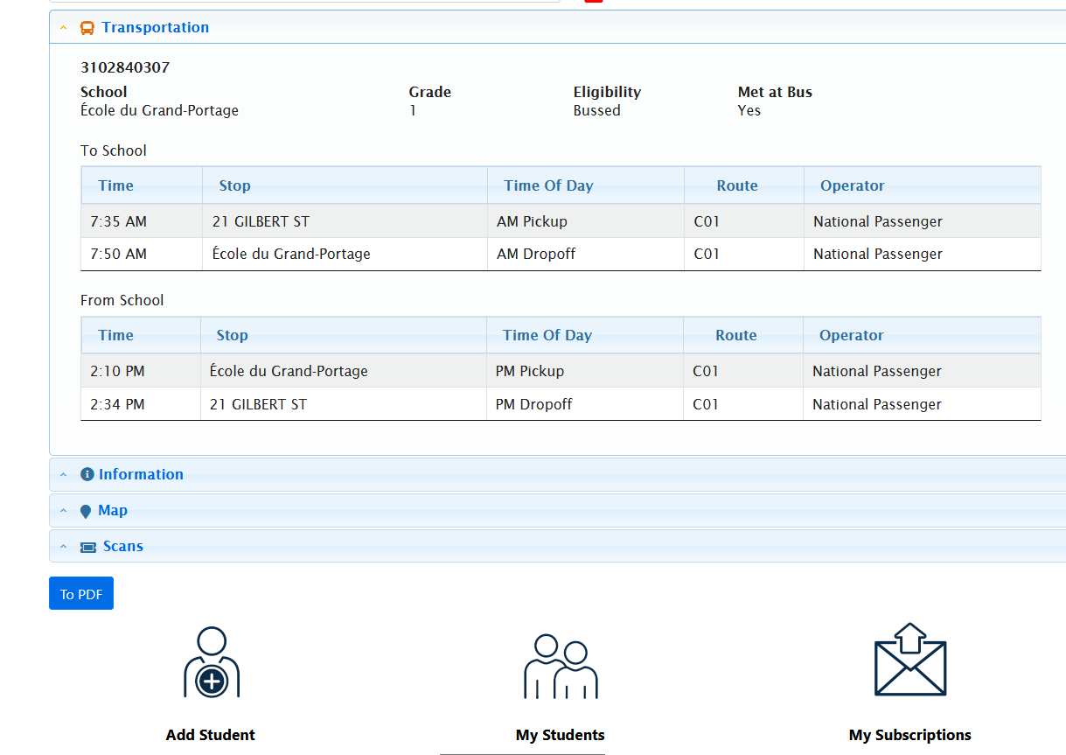
Parent portal with student bussing information

